Slide 1
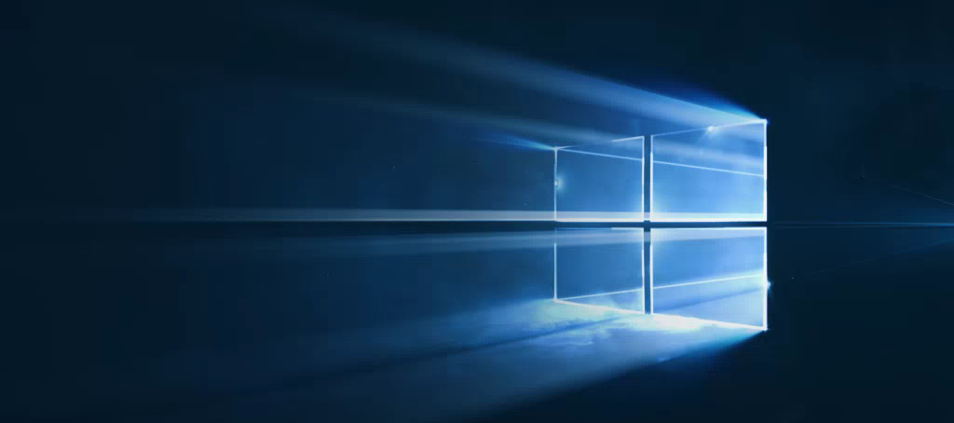
Windows
Camp //Labs
2015

Slide 2




Windows Camp //Labs
#wincamplabs

Slide 3
Более персонализированные приложения
06a
Никола Метулев
Технологический евангелист, Microsoft

Slide 4
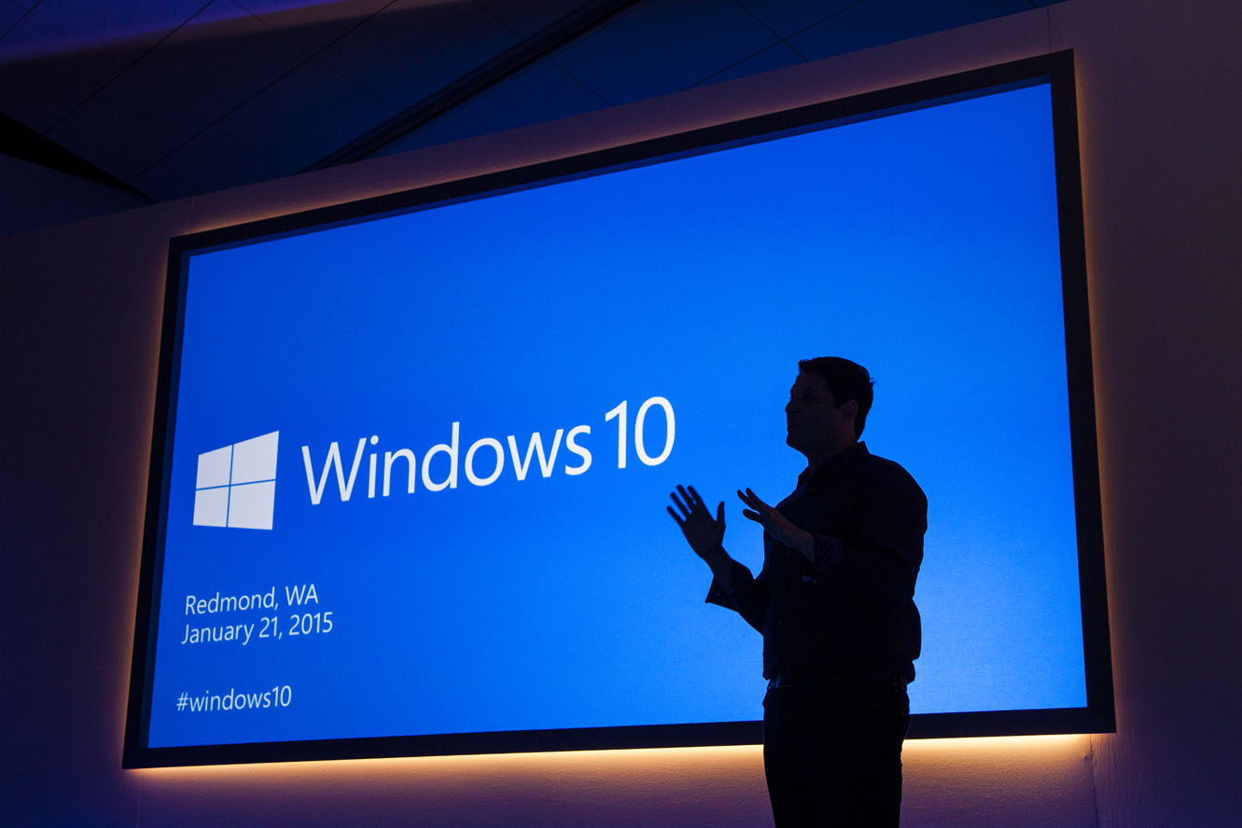
“Windows 10 is the first step to an era of more personal computing”
Terry Myerson
Notes:
Mobile first, cloud first helps us understand what happens when devices and the cloud are operating at scale together. More Personal Computing helps us think about how our interactions with our computers should evolve so that we can get more done, more quickly.
Kinect for Xbox One is a great example of a computer and an operating system that is natural and sensor aware. When you enter the room, the Kinect sees you, recognizes you, logs you in and asks you if you wish to engage. With your voice, or with gesture, or with a game controller, you can start a movie, play a game or even start up a Skype conversation. In Windows 7 and 8, Kinect for Windows brought a lot of this capability to the PC at an application level… with Windows 10, we are starting to enable this into the core operating system.
As we move into the future, our computers will do more. They will have sensors so they can start seeing the real world, they’ll use the cloud to help them understand what they’re observing, and we’re changing how we engage with them, and also how they interact with us.
We’re at start of something new and special..
While this is a different kind of computing, the reason we compute has never changed. We use computers to make the most of our precious time.
The idea behind more personal computing was whether we could add something new to how we work with our computers. What If we could engage them as naturally we can engage each other, maybe we could get stuff done faster, so we could spend more time doing whatever matters most to us.“

Slide 5

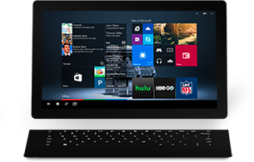

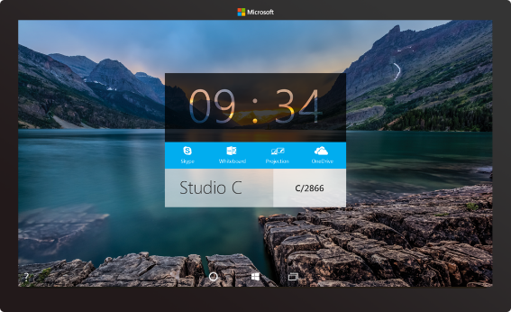
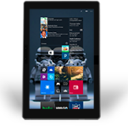
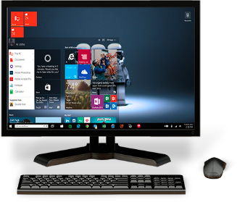
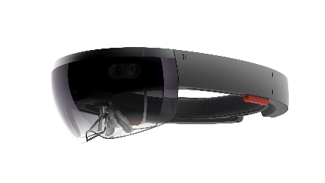
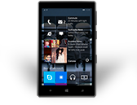

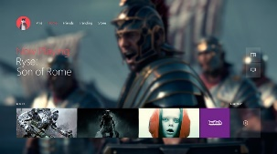
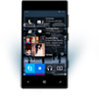
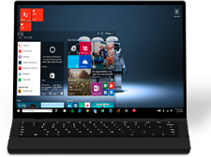
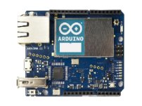
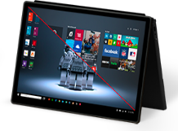
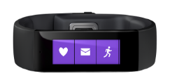

The Windows 10 family of devices
Notes:
“Windows 10 brings the technologies in more personal computing to the full breadth of Windows 10 devices.
As just one example, Cortana’s voice recognition and natural language interaction is found in devices as varied as Windows Phone, Xbox One, Surface, laptops and convertibles from our OEM partners, our giant Surface Hub screens, the Microsoft Band. And regardless of which device you’re using, Cortana knows to pick up your conversation just where you left off when you were last talking.
All Windows 10 devices share the Windows Core, and they all run Windows 10 UWP apps. For developers, there’s a single Windows store, so their app experiences can be fully mobile across all the devices users have, powered by the more personal computing found in Windows 10.
Not just Windows, we are doing a lot of work to enable this through out everything with Machine Learning and Project Oxford

Slide 6

Gesture
Identity
Speech
Ink
human technologies
Notes:
Human technologies, the natural ways we express ourselves and communicate – these oldest of communication methods are now becoming the ways we an communicate with computing devices.
The human technologies that make more personal computing a reality are in the Windows Core and available to developers and device manufactures in Windows 10
We expect to see more personal computing in devices in all shapes and sizes with Windows 10
We’d like to look at four of these human technologies that you can use in your technologies right now:
Gesture
Identity
Speech
And Ink

Slide 7
Gesture
Notes:
Let’s start with Gesture

Slide 8

You
can’t
touch
this
Notes:
Gesture covers everything from using your mouse to do something, using touch to do something, and even using a gesture in the air to do something.
Young children grow up expecting to touch something and to get a reaction, for it to’just work’, but this has not in general been a way of interacting with computers.

Slide 9
I
can
touch
this
Notes:
We’ve been improving this over quite some time – starting with Windows 8, we made the OS much more touch friendly, adding more controls for developers to use that support gestures and creating a whole gestures engine you can use to support your own custom gestures.
We’ve been increasing the capabilities so that users can interact more easily with apps using natural human technologies, so that touch and gestures ‘just work’ and the user gets the expected response when they swipe with a finger or make a gesture.
One specific example of improvements in Windows 10 is that drag and drop is now supported on all controls in UWP. We had limited support in lists in Windows 8.x, but now this extends to full support for UWP apps.

Slide 10
Gesture
Identity
Speech
Ink
human technologies
Notes:
Next in our four human technologies is Identity.

Slide 11
Identity
Notes:
With Windows 10 we are introducing many different ways of authenticating with your computer, new biometric-driven ways such as facial recognition.

Slide 12
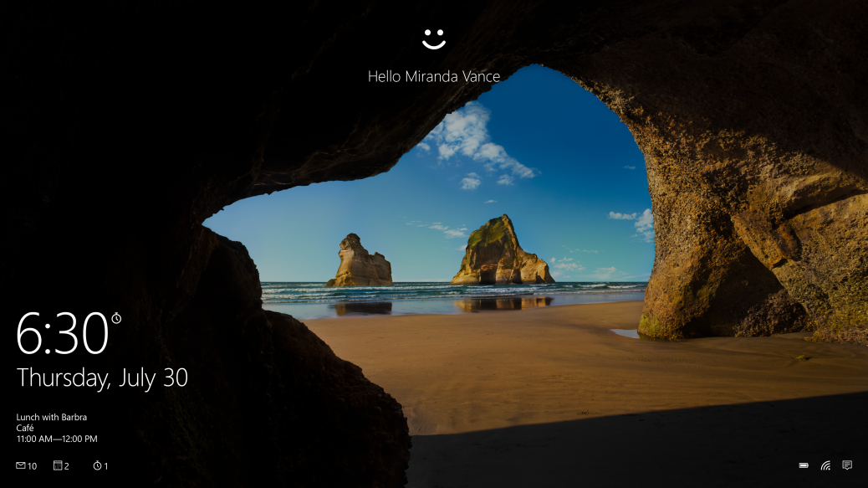
More secure, password-free experience, powered by Windows Hello and Passport
Windows Hello
Biometric authentication (face, iris, fingerprint)
Convenient, Consistent
Enterprise level security
Passport
More secure
Simplifies authentication through single “unlock gesture”
Just works Azure Active Directory services
Access to major SaaS services
Office 365 Exchange Online, Salesforce, Citrix, Box, Concur,
Notes:
We’ve introduced a new technology called ‘Windows Hello’ which allows you to do biometric authentication. We support Face, Iris and fingerprint recognition. All these things require specific hardware, but devices idorporating this hardware are starting to become available.
We’ve also got a service for application developers called Passport which provides a secure framework for handling authentication and for replacing passwords with these new authentication techniques. You can easily build biometric recognition features into your app.

Slide 13
Gesture
Identity
Speech
Ink
human technologies
Notes:
Next up: - Speech

Slide 14
Speech
Notes:
Speech is probably the most obvious area where Windows 10 advances support for human technologies.
For most people, Speech means ‘Cortana’ and are curious on how to integrate Cortana into their own applications. Cortana is not available everywhere, although Microsoft is working hard to roll it out to more territories, but even if Cortana is not supported in your home territory, end users may buy your app in regions where it is, so you may still want to know how to support it.
The majority of the Speech platform is independent of Cortana and apps can use it without integrating with Cortana. The Speech platform consists of APIs and controls hat can help your app support speech input and speech synthesis, whether or not you integrate with Cortana.

Slide 15

Speech Recognition and Synthesis done easy
Use SpeechRecognizer for continuous or one time recognition
Use SpeechSynthesizer for speaking back
Notes:
Key parts of the Speech platform that are available everywhere are APIS for speech recognition and for speech synthesis, and all app developers can make use of these APIs.
The SpeechRecgnizer and SpeechSynthesizer APIs are available everywhere and do not require Cortana at all.

Slide 16
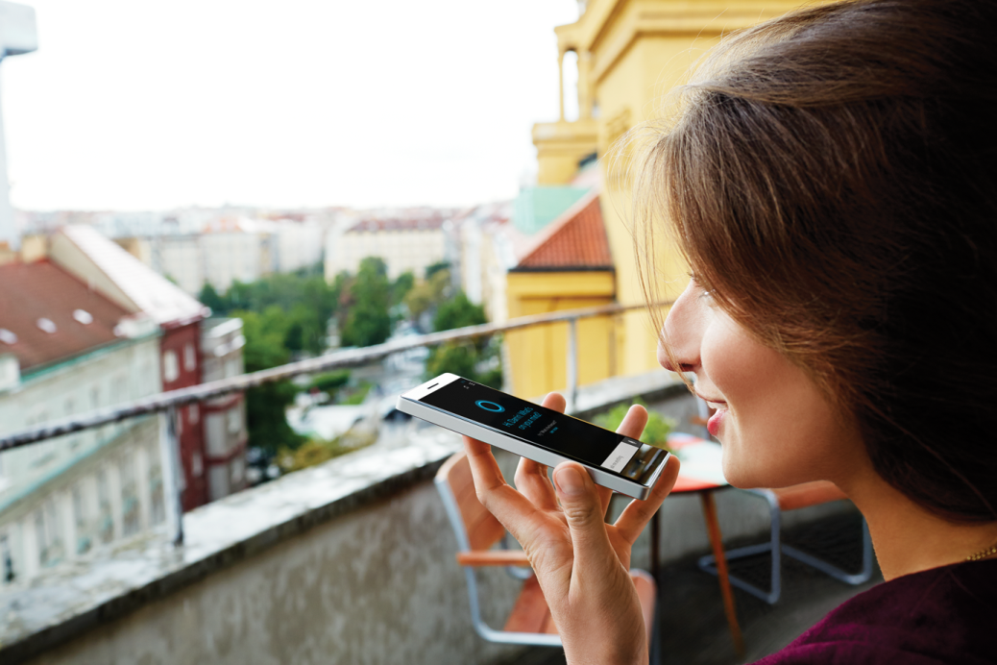
Cortana
Teach Cortana to use your app on my behalf and
contextually activate your app
retrieve information or execute an action
without loosing focus
Notes:
But what if you do want to use Cortana?
Windows Phone 8.1 developers have been able to add these features for a while, but now it’s becoming available on desktop too.
You can get Cortana to launch your app using voice commands.
But on Windows 10, we’ve extended these capabilities as well, so there is now the ability for Cortana to interact with your apps’ background task, to exchange information with it. This is great, as it allows your user to perform speech interactions with your app without your foreground app being launched at all, making natural, speech-driven interactions with your app easy for your users.

Slide 17
Gesture
Identity
Speech
Ink
human technologies
Notes:
Next up in our human technologies: Ink

Slide 18
Ink
Notes:
Writing with an implement or finger is of course one of the earliest human technologies for making a permanent record of something, and one we’ve tried to support in computing for quite a while, but only with limited success.

Slide 19

Writing is human
Notes:
Writing is one of the most natural of human communications. It’s
Immediate
Expressive
Personal
It’s quick – if you want to record something, you just grab a pen and write it down.
[Presentation Note: If you are presenting on a Surface device, at this point take the Surface pen and write something directly onto this screen.]
It’s expressive – you’re not limited to whatever keys are present on your keyboard, you can write and draw just whatever you want.

Slide 20
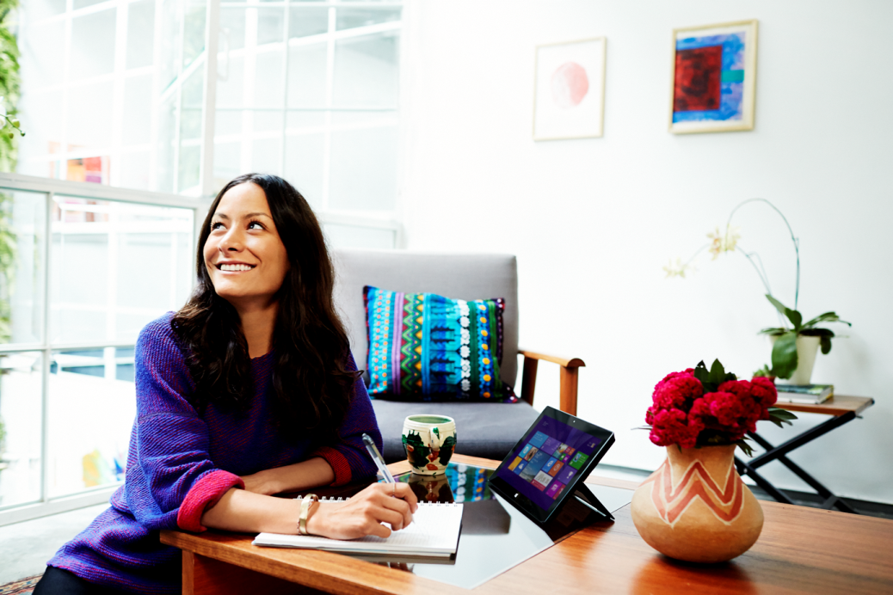
DirectInk: New ink platform for Windows apps
Inking Support on PC, Tablet & Phone
Renders beautiful ink with low-latency
Improved Comfort and Confidence
Easy to use building blocks for apps
Configure for different input types (Pen, Touch, Mouse, etc.)
Change Drawing Attributes
Manage Ink Stroke Data
Access more customization options
Notes:
In Windows 10, we’ve done a lot of work in the very lowest parts of the operating system to drive out the latency or ‘lag’ that in the past prevented writing on a computer screen feeling truly natural.
In previous versions of Windows, you had to do a lot of work to support inking input and ink recognition (converting written input into text), but on Windows 10, we’ve made this super-simple using a new platform called DirectInk. It’s very efficient, renders everything using DirectX running off the UI thread so doesn’t cause slowdown of your app UI.
Supports many different input types such as Pen, highlighter, touch etc

Slide 21
Lab: Working with Ink Input

